Slide 1
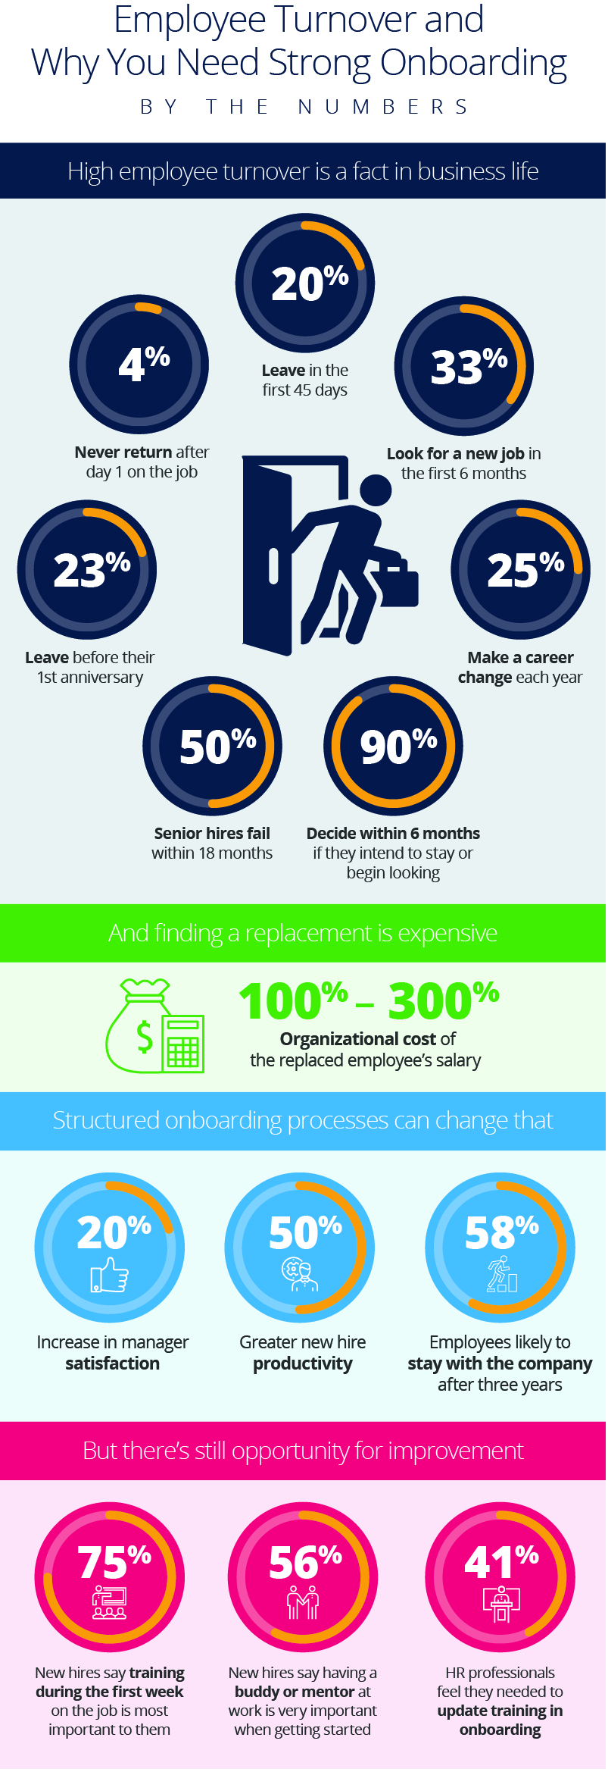
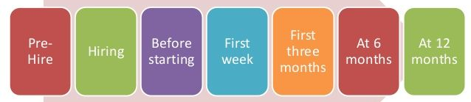
Data points - Icebreakers
Business Talk
Pitch
Trump Cards
High Employee Turnover is part of Business Life
Expect these Customer Pain Points
Value Proposition
References
Employee Retention
Do not have a good on-boarding program
Manually driven on-boarding, prone to mistakes
Maintaining information in spreadsheets across organization
Very paperwork centric and mechanical
Job responsibilities in variance with current responsibilities due to shift of business priorities
Require a mobile interface
Nimble and quick process
On-Boarding currently requires about 40+ activities
Intuitive and immersive user experience
Support multiple platforms including Mobile
Most compliances implemented as applicable to India Laws
Intelligent forms to avoid mistakes and repetition
Fully workflow driven with less manual intervention
Automated task notification
Customizable with minimal effort
Fully Secure and role-based access
On-boarding process tracking continues up to one year+
Easy Reporting and exporting
List out your key customers
Provide contact of your customers who can provide you a good reference
Arrange a demo at a customer site for authenticity
Provide resumes of your key Project Managers /Implementors
Ask these Golden Questions
Offerings
Are you happy with your employee retention rate?
Do you feel that your employees have been happy with the On-Boarding process?
Is your on-boarding process automated or manual?
Do you think your HR is burdened by the on-boarding process?
How involved are your managers with On-Boarding?
Do you have a training program for new employees?
Do you require assistance in the best On-Boarding practices adapted by successful companies?
Are you willing to invest in the near future if you have a guarantee of definitive ROI?
What is the timeframe that you wish to automate?
Fully functional and configurable On-Boarding software
Has all pre-defined documents required which are customizable to your organization
Help in implementing in your organization and train your personnel to use it
Offer supplementary services to lay out the strategy for On-Boarding
Post implementation support for additional features and warranty for implementation
Start the process before an employee is hired and track for 12 Months
Who to Target
HR Managers
CTO
CEO
Structured On-Boarding can change that
We are talking about -
and more opportunities for improvement
You have a on-boarding software or service to sell. This battlecard will help your salespersons give a consistent pitch to your customers and get the conversation going. In-experienced salespersons can take the help of the battlecard to prepare for a customer meeting by asking relevant questions.

