Slide 1
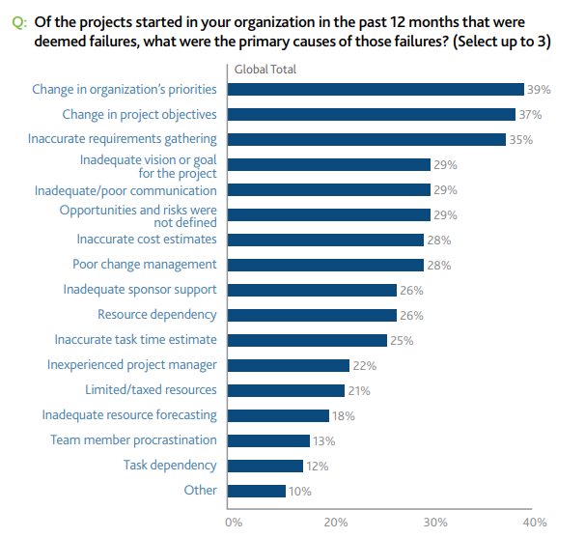
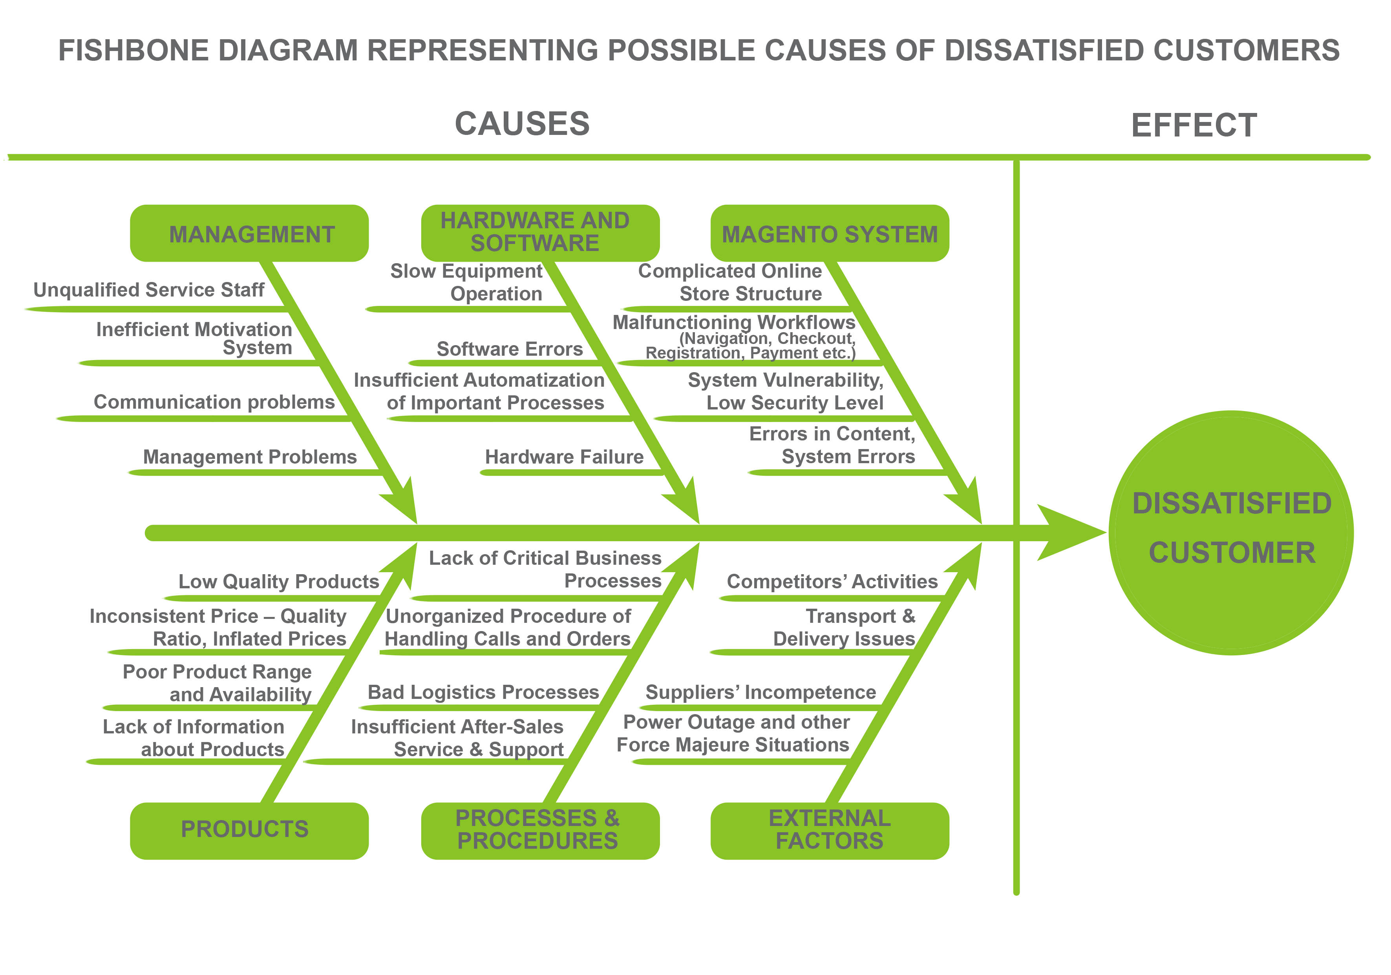
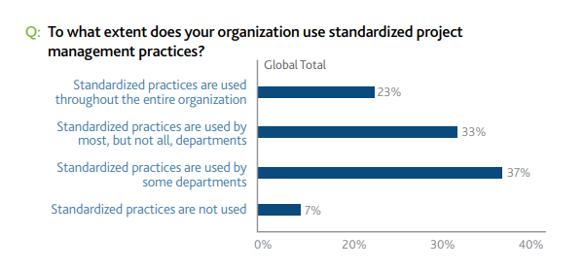
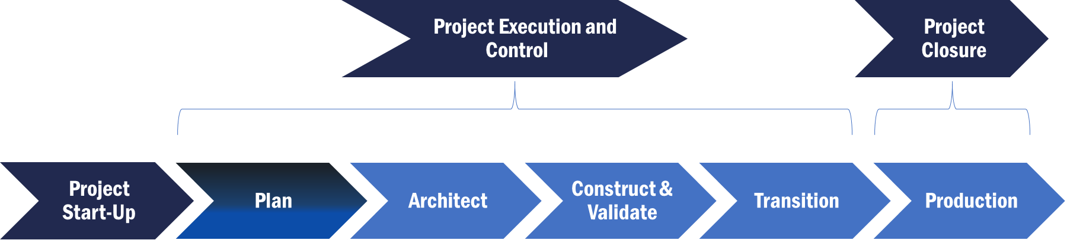
Data points - Icebreakers
Business Talk
Pitch
Trump Cards
Expect these Customer Pain Points
Value Proposition
References
Rigid architecture
Accuracy in estimates
Changing/variation in requirements
Mis-interpretation of IT technology
De-centralized employees
Insufficient / No Risk Planning
Learning from past mistakes/repetition of mistakes
Describing the project that everyone understands in the same way
Accountability
Our methodology offers various flavors directed specifically at Project Managers and execution teams
Support Agile, Waterfall and Hybrid implementations
Adaptable to standalone in-house and on-prem project as also to Cloud technologies
Detailed explanation and templates available at every stage and task level for the entire project lifecycle
Follows a modified consistent approach based on PMI, Oracle Unified Methodology, Agile with our own custom improvements
List out your key customers
Provide contact of your customers who can provide you a good reference
Arrange a demo at a customer site for authenticity
Provide resumes of your key Project Managers /Implementors
Ask these Golden Questions
Offerings
Are you able to define your existing business process thoroughly?
Are you using a traditional methodology or are you following an Agile process?
How open are you to following a repeatable process that delivers consistently time and again?
How do you record your mistakes so that they do not repeat, would you like to create your own referenceable knowledge bank?
Are your projects close to initial estimates when completed?
Would you like your project personnel to get trained in a methodology that is consistent and adaptable to your own unique situation?
Train your personnel and implement BIAS methodology in your organization
Provide a defined path for Project Managers to track all activities from a project management perspective
Provide various flavors of execution focus to include Agile, waterfall and hybrid models
Tailormade for ERP, Middleware and generic software development
Methodology mapped to ensure all artifacts required are compliant with a CMMI implementation (Separate branch)
Who to Target
IT Managers
Program Managers
Product sponsors
We are talking about -
Tektalk Methodology showcases a consistent approach to deliver projects with a rich set of presentations, explanations and fully downloadable templates to ensure success for any kind of project. It is adaptable to Agile, waterfall, hybrid and if required can ensure CMMI compliance by including the required plug-in

